Slide 1
Agile Development & Scrum
Lic. Santiago Rodríguez Paniagua. (2014)

Slide 2
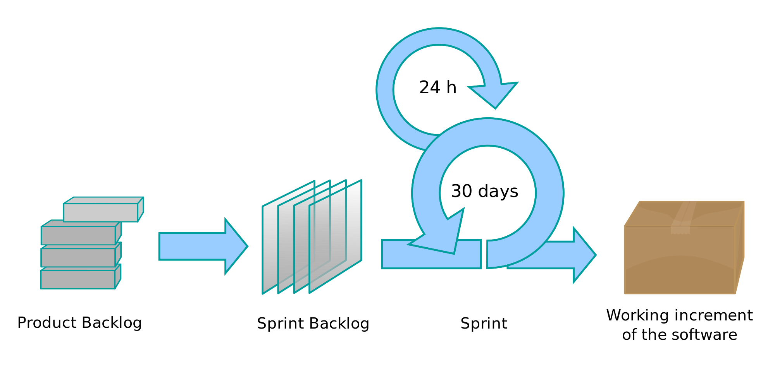
Scrum

Slide 3
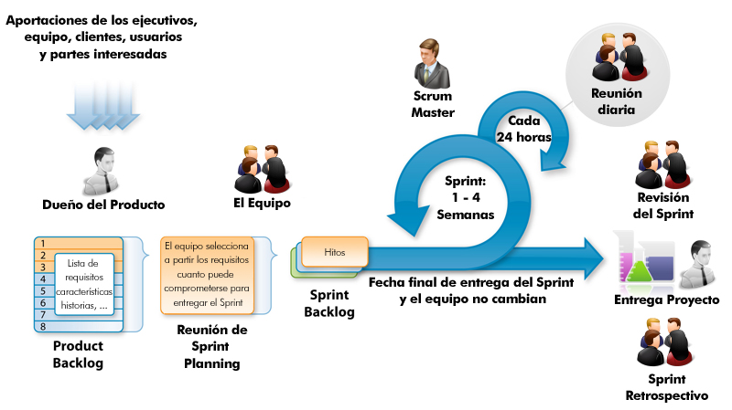
Scrum #2

